Slide 1
Presentation on
Loan Predication Problem
-----Hai DU

Slide 2
Overview Of The Data
Gender (0/1)
Married (0/1)
Dependents (1,2 3+)
Education (Grad/Not)
Self-employed (0/1)
Credit_History (0/1)
Property_Area (Urban/Rural/Semiurban)
Loan_Status( 0/1 response variable)
Loan_ID
CoapplicantIncome
LoanAmount
Loan_Amount_Term
Applicant_Income
Total 615 observations

Slide 3
Objective
Mainly Two Objectives
Identification of relevant attributes
The objective is to identify if the applicant’s loan could be approved and classify if a customer will default on a loan using a logistic regression model.

Slide 4
Tidying The Data
Explore data visually/ non-visual exploration
Explore relationship
Find missing value
Treat missing data
Detect types of missing data (Missing at Random )
replacing missing values with multiple Imputation
Impute the missing values using the mean of each feature separately.
Handling null, outlier and categorical variables
Setting up multicollinearity test
Building Logistic Regression Model

Slide 5
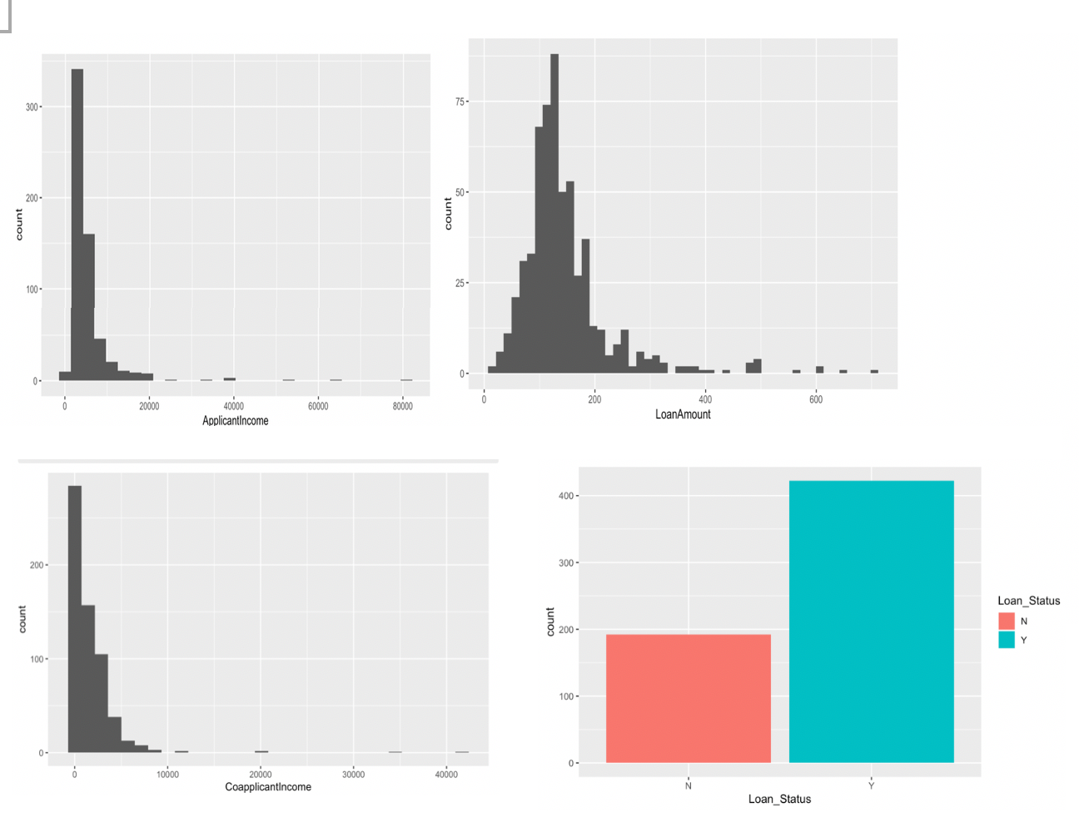
visual exploration
right skewed
outlier

Slide 6
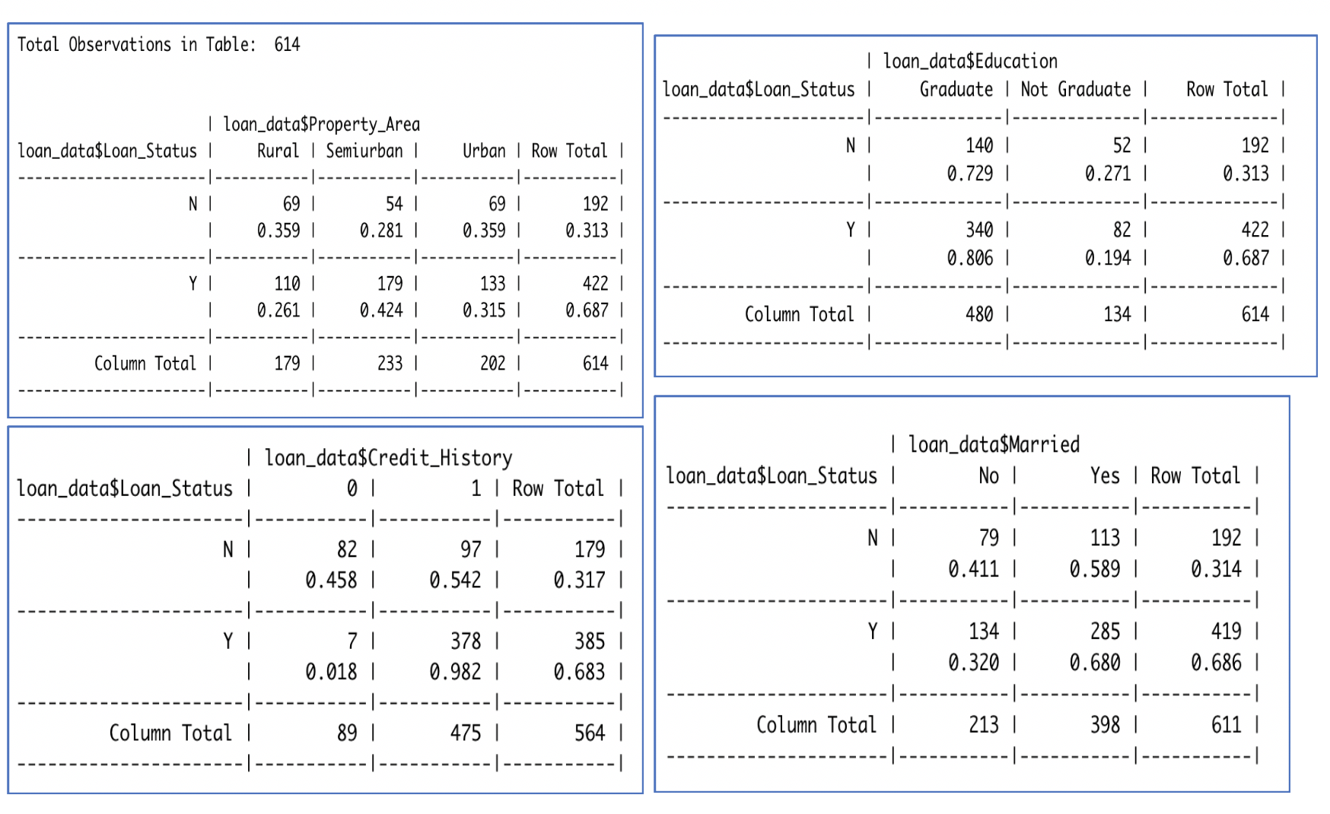
Making Contingency Table to check percentage of predictors in relation with loan status

Slide 7
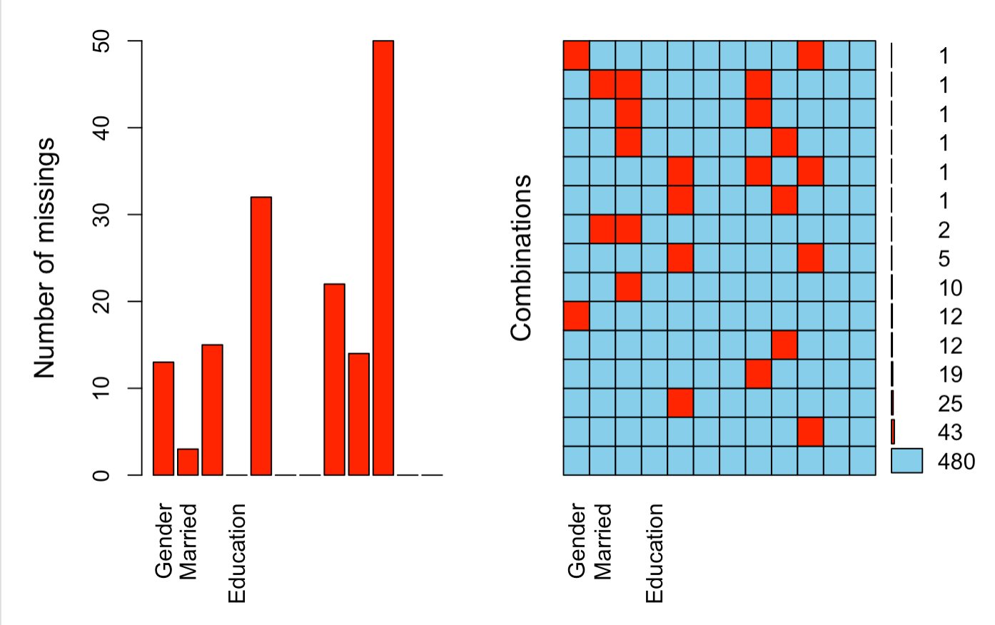
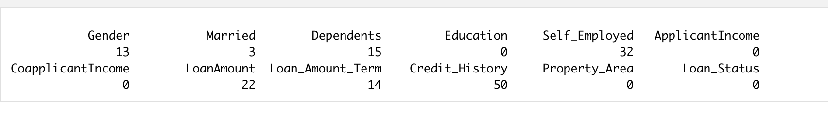
Checking For Any Missing Values In For The Predictors

Slide 8
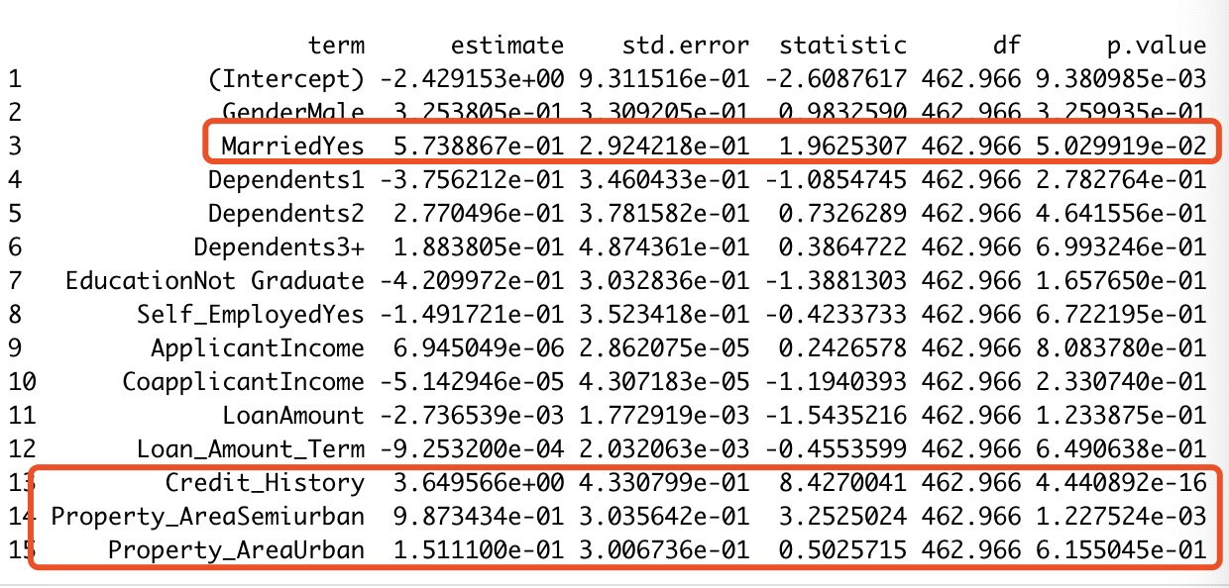
Multiple Imputation Result

Slide 9
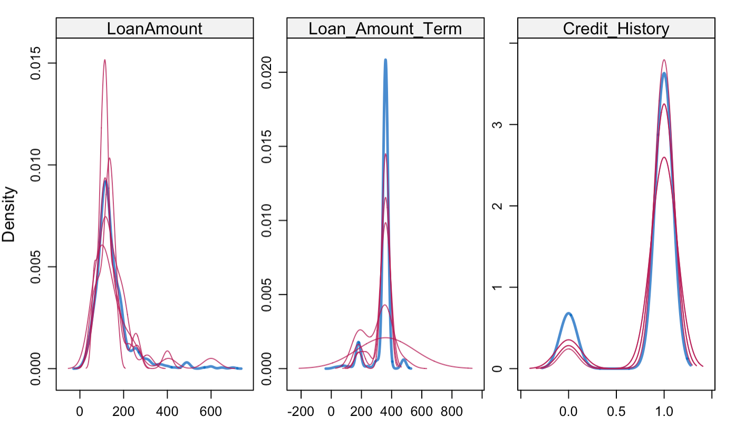
Inspecting The Distribution Of Original And Imputed Data
The density of the imputed data for each imputed dataset is showed in magenta while the density of the observed data is showed in blue
What we would like to see is that the shape of the magenta lines (imputed) matches the shape of the blue line (observed). The matching shape tells us that the imputed values are indeed “plausible values”. Again, under our assumptions we expect the distributions to be similar.

Slide 10
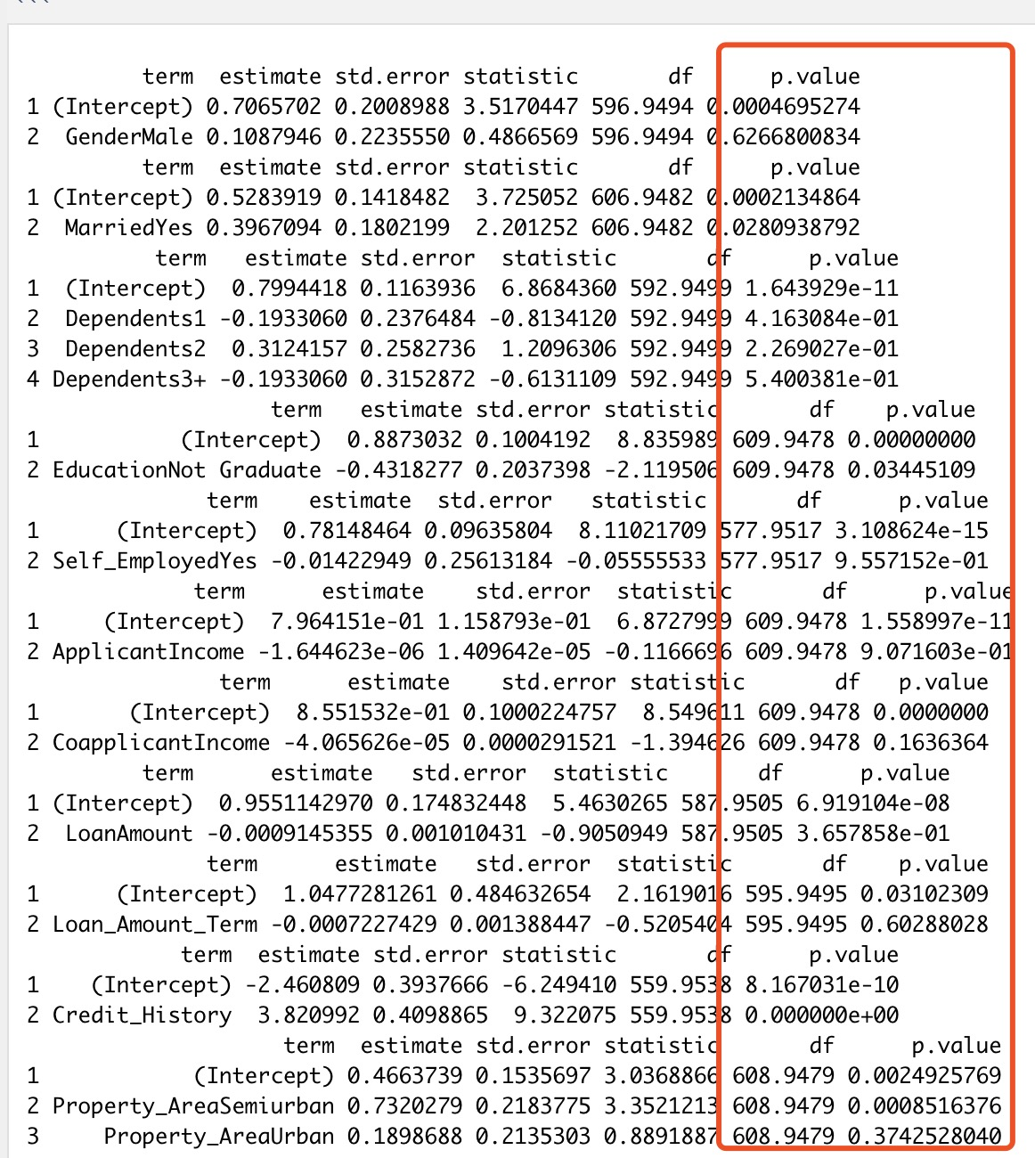
Building Logistic Regression Model
Forward stepwise selection strategy
step1
Running fit “simple” logistic regression models for each of the predictors separately. Eliminate any predictor values with large p-values (say >0.2).
We find that Married, Education, CoapplicantIncome and Credit_History have p-values less than 0.2.
Putting them in the model together

Slide 11
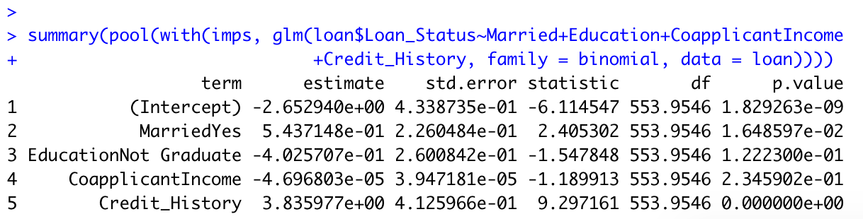
Forward stepwise selection strategy
step1
Putting them in the model together

Slide 12
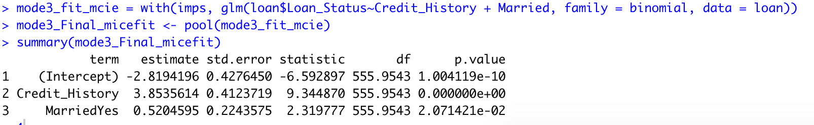
Forward stepwise selection strategy
step2
Conduct forward/backward stepwise selection with remaining predictors
Using a more stringent cut-off, such as p-value<0.1

Slide 13
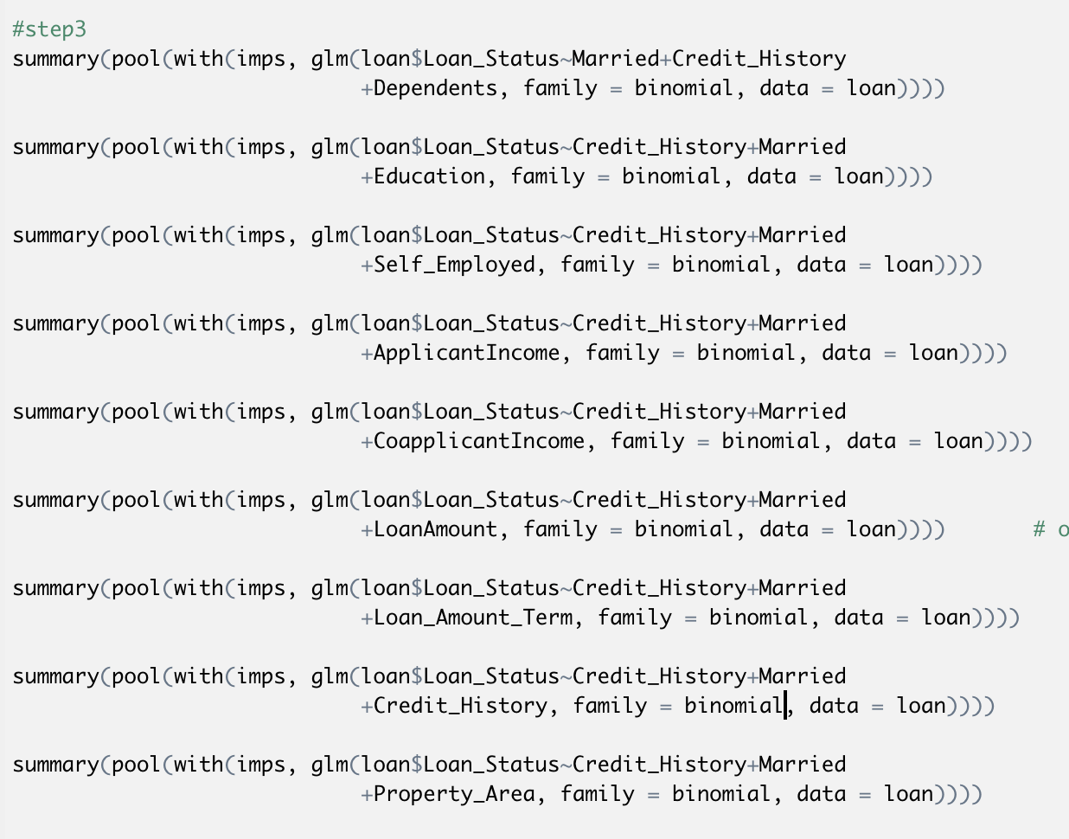
Forward Stepwise Selection Strategy
Step3
Then, starting with a model with just Married and Credit_History. We try adding back in each of the other predictors.
Adding in Loan_amount changes the other effects(Married) the most, I added it in first. Then,
Then adding in other predictors does Not change anything by 10%
I also consider use stepAIC() to look at the step3.

Slide 14
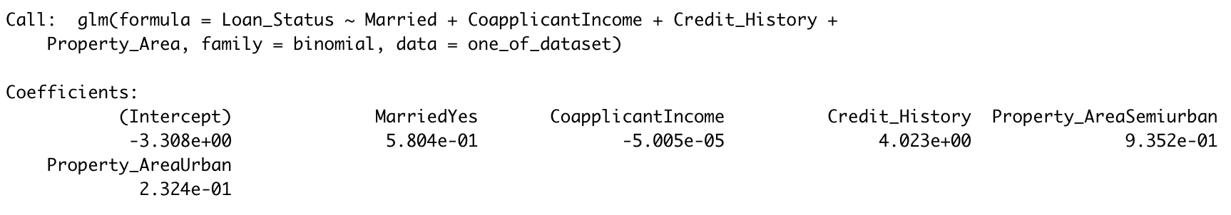
Forward Stepwise Selection Strategy
Step3
Runing stepAIC() multiple time for different complete dataset, we know the smallest AIC will always
Include Married, Credit_History and Property_Area, then CoapplicantIncome, LoanAmount and Education appear frequently

Slide 15
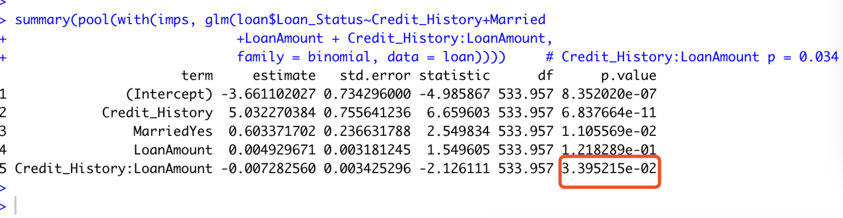
Forward stepwise selection strategy step4
Finally, attempt adding plausible interactions among variables in the model, usually using somewhat stricter standards such a p-value<0.05.
Attempt adding plausible interactions among variables in the model, only Credit_History*LoanAmount is significant in the model with p =0.034
Thus, our final model predictors includes
Married,
Credit_History,
LoanAmount
Credit_History: LoanAmount

Slide 16
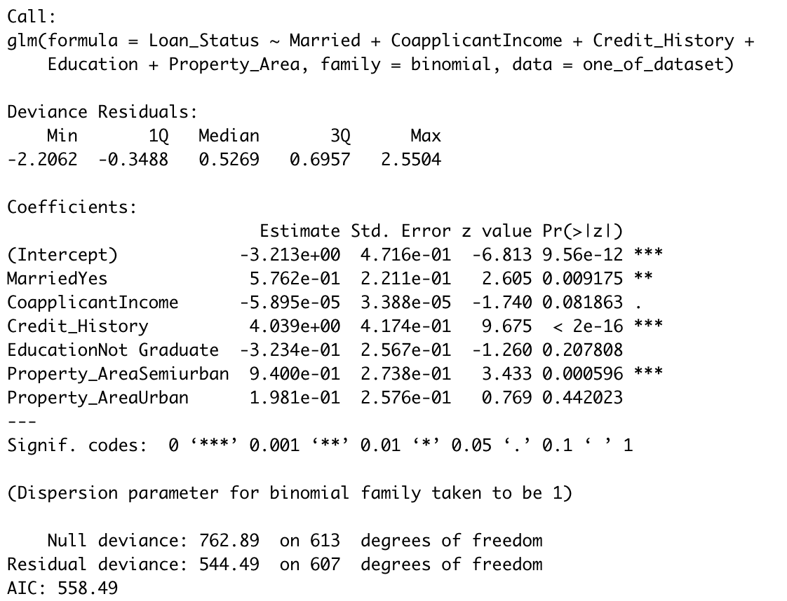
Just curious, now we can get back then completed dataset, the missing values have been replaced with the imputed values in the first of the five datasets.
We pick on of the dataset doing some analysis.

Slide 17
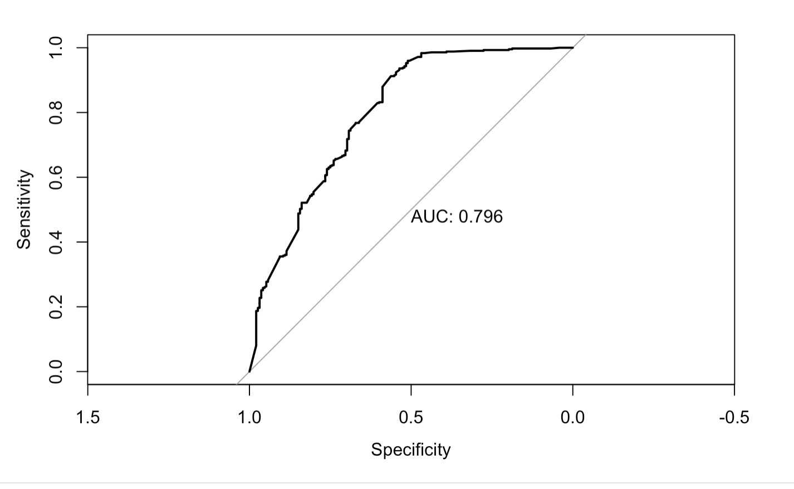

Slide 18
Tidying The Data
Explore data visually/ non-visual exploration
Explore relationship
Find missing value
Treat missing data
Detect types of Missing Data(Missing at Random )
replacing missing values with multiple Imputation
replacing missing values with means/medians
Handling Null, Outlier
Setting up multicollinearity test (Correlation Matrix on Dataset)

Slide 19
Replacing Missing Values With Means
The missing value can also be imputed with the measure of central tendency.
for categorical data, use the category that appears most frequently
Replace outlier with lower and upper cutoff value

Slide 20
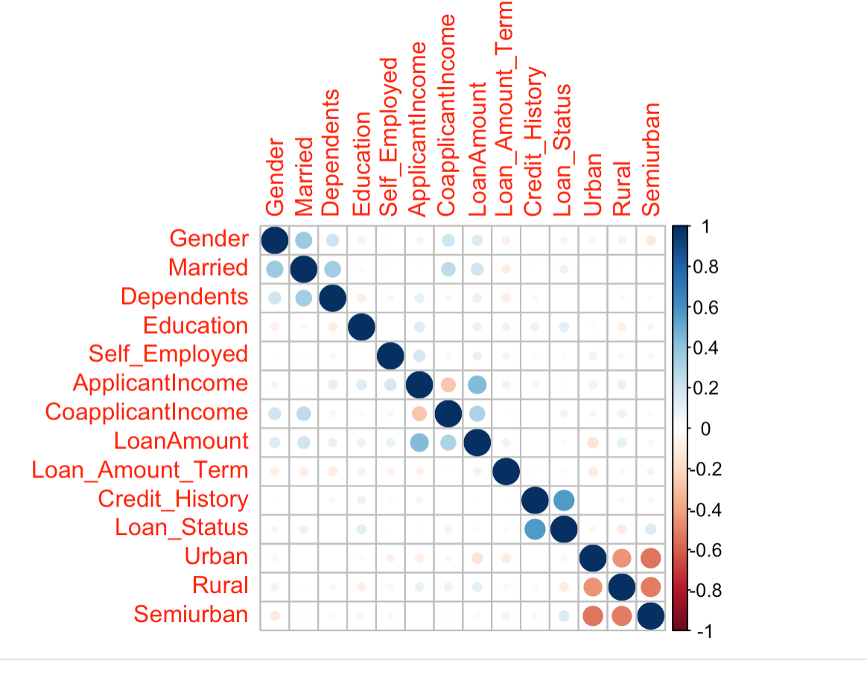
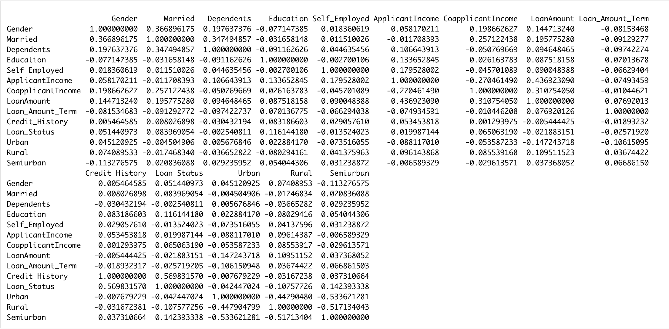
Setting Up Multicollinearity Test

Slide 21
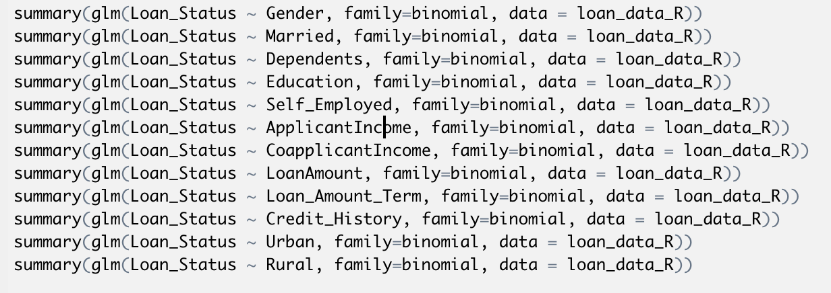
Step1
Fit “simple” logistic regression models for each of the predictors separately. Eliminate any predictor values with large p-values (say >0.2).

Slide 22
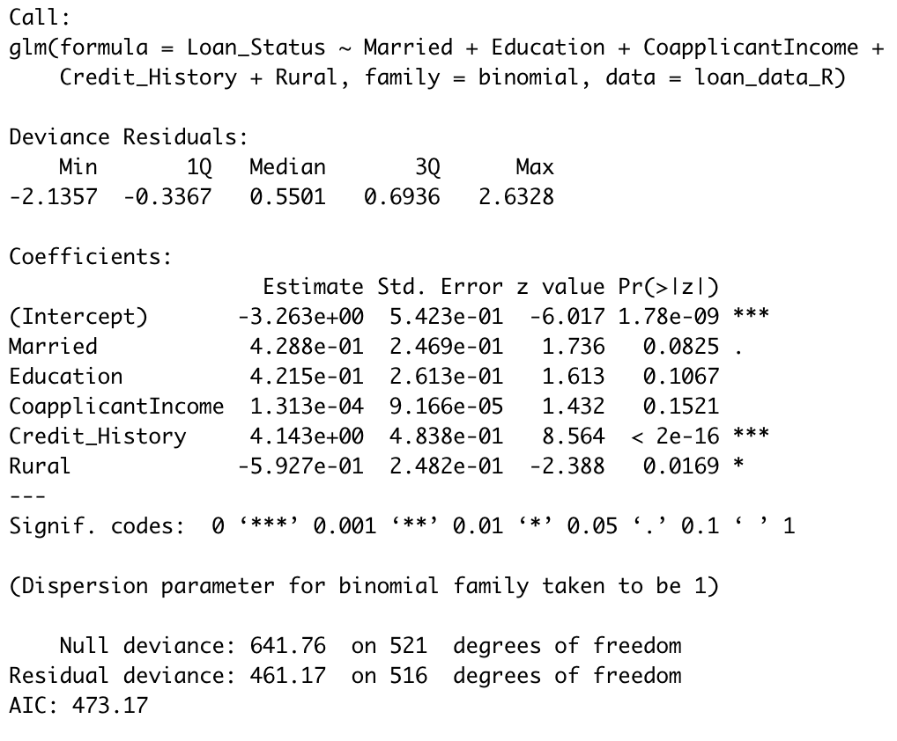
Step1
Fit “simple” logistic regression models for each of the predictors separately. Eliminate any predictor values with large p-values (say >0.2).

Slide 23
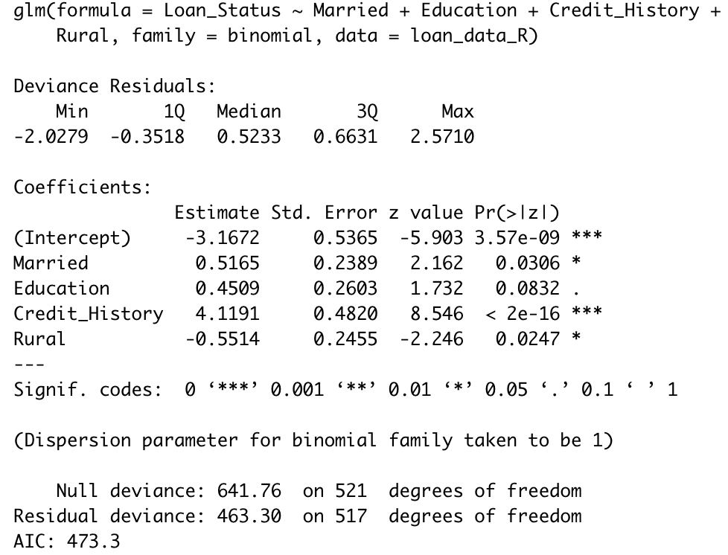
Step2
Conduct forward stepwise selection with remaining predictors, usually using a more stringent cut-off, such as p-value<0.1

Slide 24
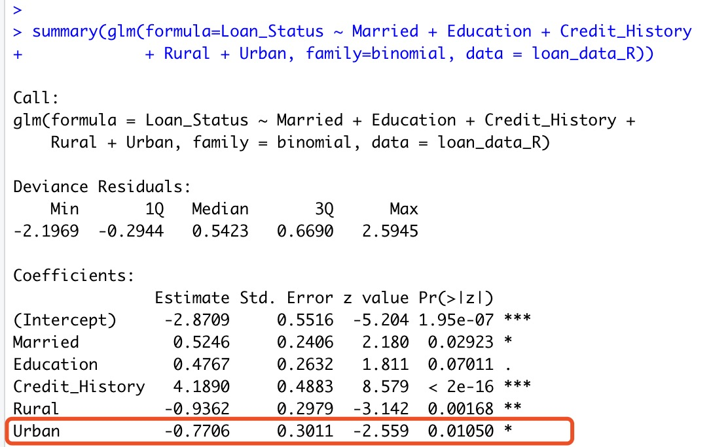
step3
Consider adding in any variables that were not included in the model after Step 1 or Step 2
Since Urban has a p-value is relatively small threshold and changes the other effects the most, I added it in first.

Slide 25
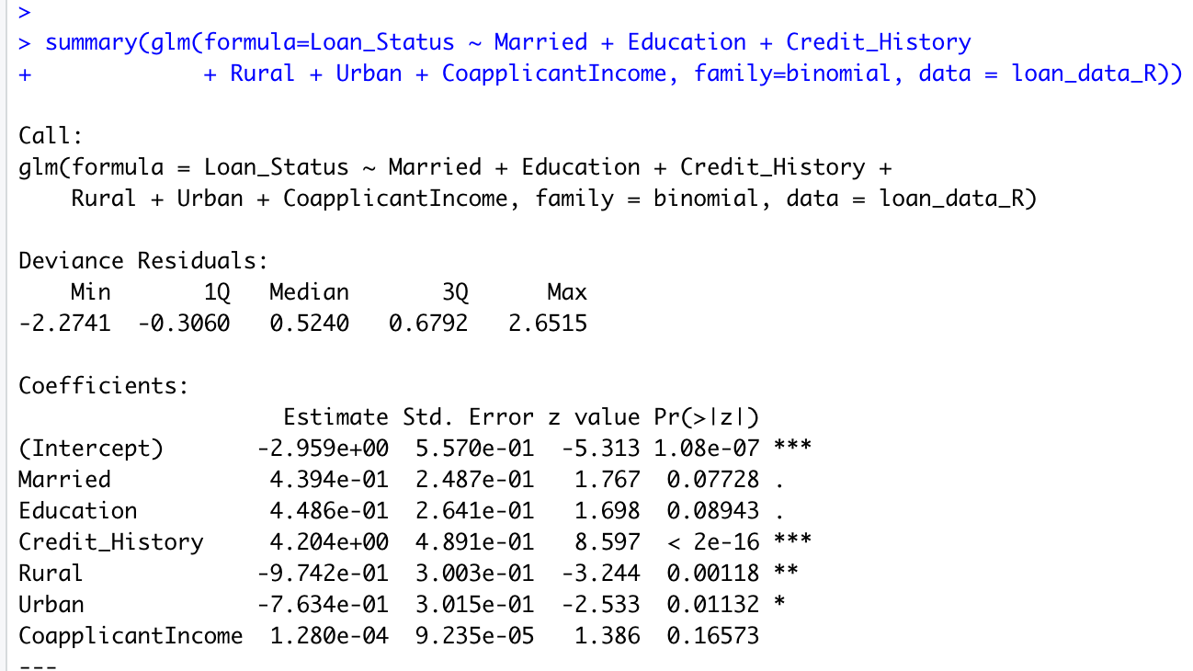
Then, adding in CoapplicantIncome change Married around 17% and Rural about 30%

Slide 26
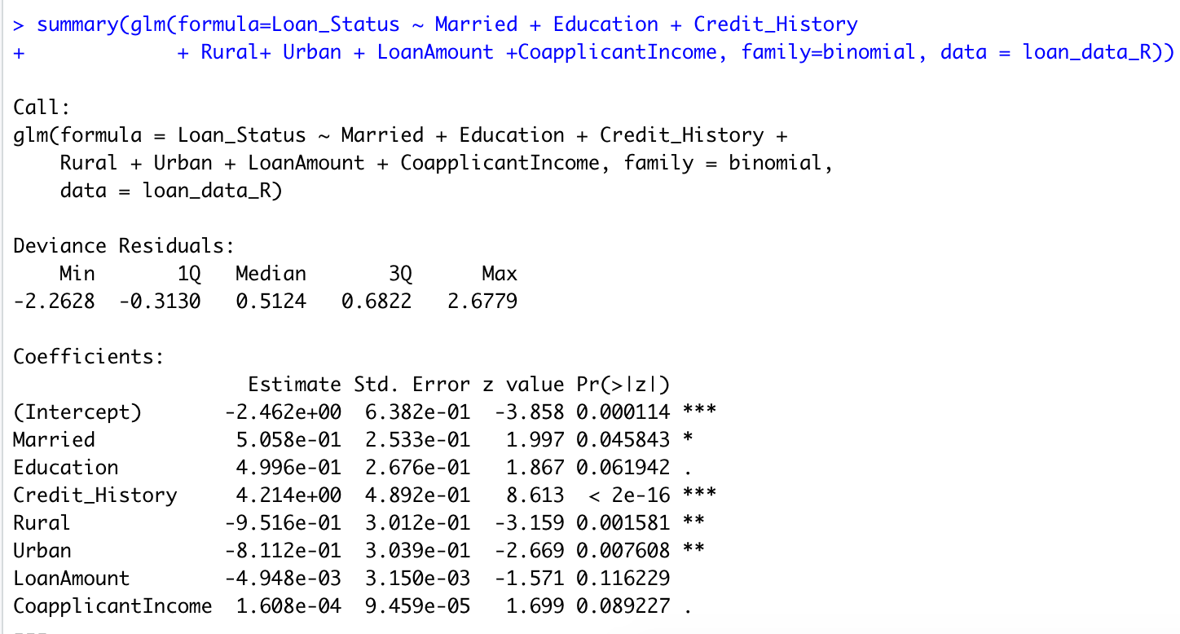
Then, adding in LoanAmount change Married and CoapplicanIncome by at least 10%
Adding other predictor such as Self_Employed, ApplicantIncome will also change other effects around 10%, but p value is relatively large, therefore, I consider not to add these predictors into the model.

Slide 27
Finally, considering some interactions but does not produce anything extra
Thus, our final model included
Married
Education
Credit_History
Rural
Urban
LoanAmount
CoapplicantIncome

Slide 28
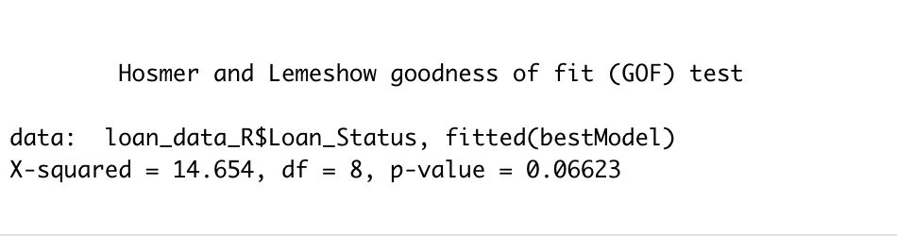
Hosmer-lemshow Test
Hosmer-Lemshow Test
Ho: Model fits vs. Ha: model lacks fit
we can use the Hosmer-Lemeshow test, which here gives a p-value of 0.06623, indicating that our model does not have an obvious lack of fit (it seems reasonable).

Slide 29

ROC Curve

Slide 30
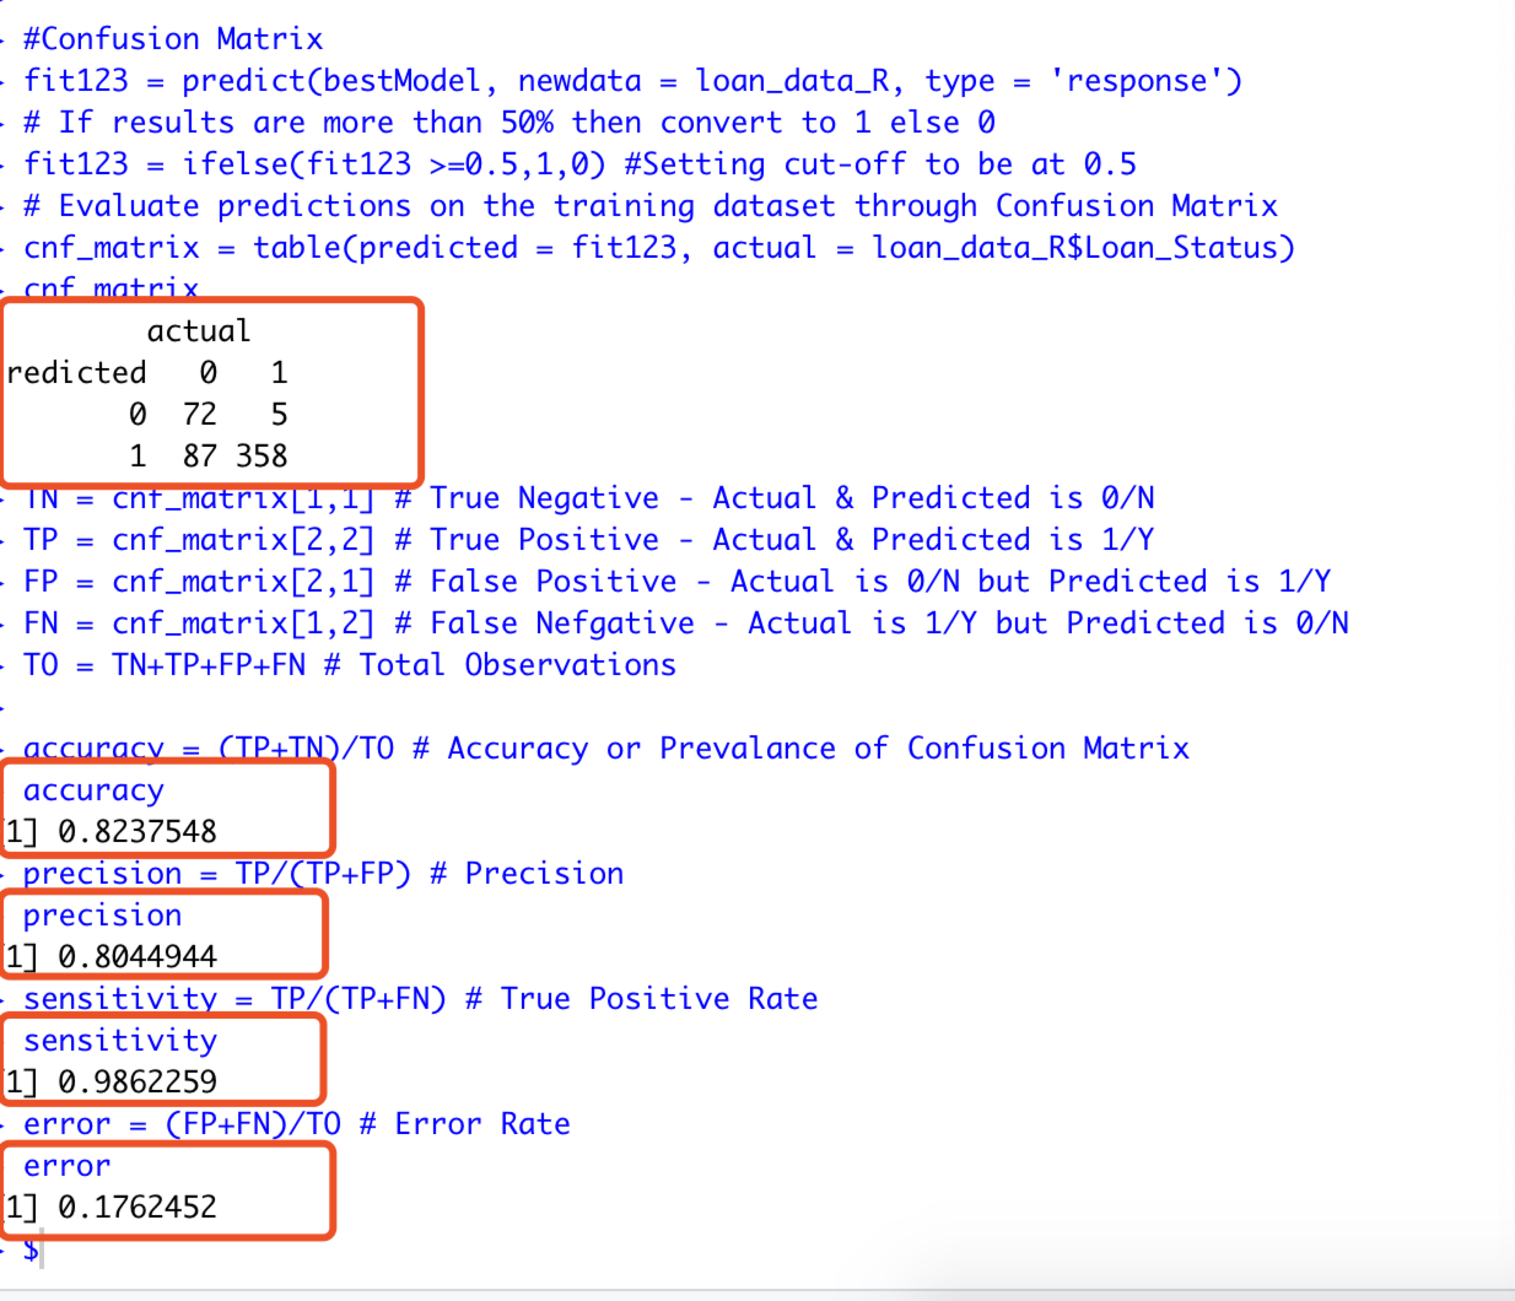
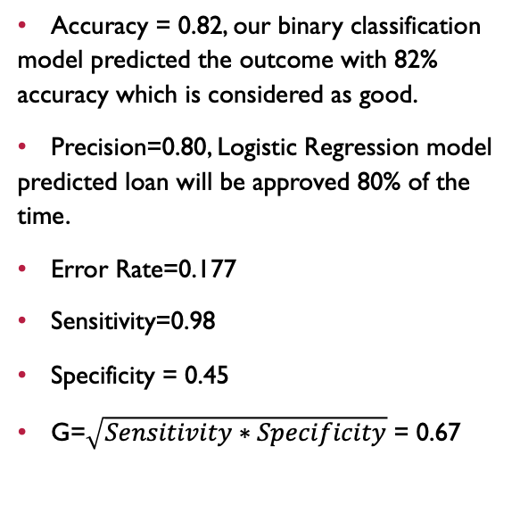
Accuracy Test
Classification table
Accuracy = 0.82, our binary classification model predicted the outcome with 82% accuracy which is considered as good.
Precision=0.80, Logistic Regression model predicted loan will be approved 80% of the time.
Error Rate=0.177
Sensitivity=0.98
Specificity = 0.45
G=$\sqrt{Sensitivity∗Specificity}$ = 0.67

Slide 31
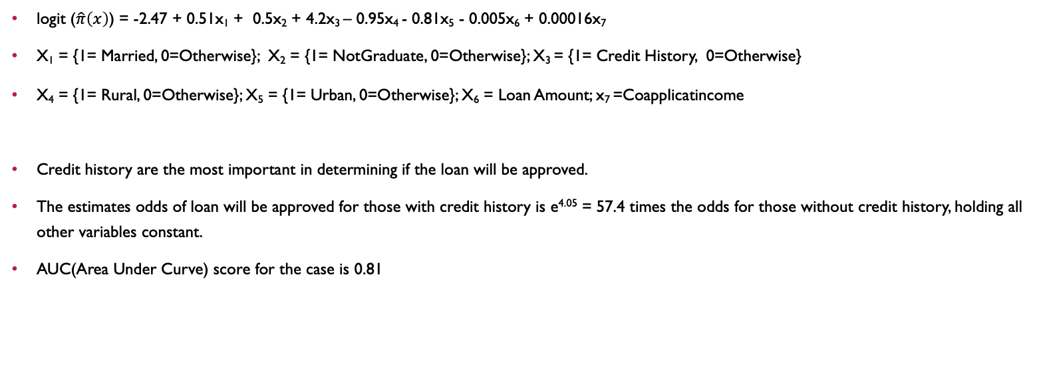
Conclusion
logit ($\hat{π}\left(x\right)$) = -2.47 + 0.51x₁ + 0.5x₂ + 4.2x₃ – 0.95x₄ - 0.81x₅ - 0.005x₆ + 0.00016x₇
X₁ = {1= Married, 0=Otherwise}; X₂ = {1= NotGraduate, 0=Otherwise}; X₃ = {1= Credit History, 0=Otherwise}
X₄ = {1= Rural, 0=Otherwise}; X₅ = {1= Urban, 0=Otherwise}; X₆ = Loan Amount; x₇ =CoappIicatincome
Credit history are the most important in determining if the loan will be approved.
The estimates odds of loan will be approved for those with credit history is e^{4.05} = 57.4 times the odds for those without credit history, holding all other variables constant.
AUC(Area Under Curve) score for the case is 0.81

Slide 32
Limitations
Missing values sometimes add more information to the model than we might expect
How to select the best dataset after multiple imputation in MICE to build other models
The Purposeful selection was not designed to force all dummy variables in the model (for instance, one that has three nominal levels which corresponds to two dummy variables that need to be considered as a unit in model inclusion). Other selection procedures have this limitation as well, unless we force dummy variables in the model
Imbalanced dataset

Slide 33
Thanks!

Slide 34
references
https://www.kaggle.com/ninzaami/loan-predication
https://www.ncbi.nlm.nih.gov/pmc/articles/PMC2633005/

